Slide 1
Perspective of shelter staff Dean Carpenter FNP-BC February 7, 2012
“Always within Reach…”

Slide 2
Nso services
Substance Abuse Treatment and Prevention Services
Older Adult Service
Emergency Telephone Service
Harper-Gratiot Multi-Service Center
Food bank
Clothing
Utilities
Youth Initiative Project
Gambling Addiction Treatment
Employment Training Services
Life Choices (developmental disabilities)
Homeless Services
Supportive Housing
Road Home
Tumaini Center

Slide 3
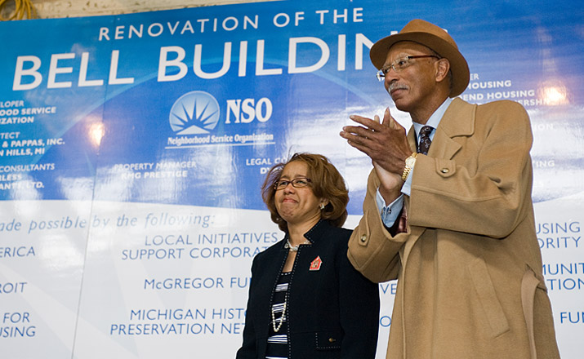
Bell building
155 One-bedroom apts
NSO Corporate HQ
FQHC
Laundry
Chapel
Walk-out gardens

Slide 4
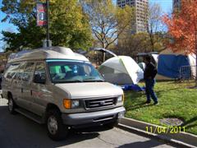
Road Home
Outreach Homeless Services –
seen here supporting
Occupy Detroit at
Grand Circus Park
D. Carpenter 2011

Slide 5
Nso tumaini center
Source: MSU “Spartan Sagas” 2011
The shelter of last resort in the Cass Corridor
Notes:
Tumaini – Swahili word meaning “hope”.

Slide 6
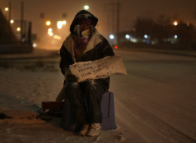
Scope of the problem
D. Carpenter 2010
Source: Huffington Post, 2009
Estimated 19,000 homeless in Detroit
Unemployment rate 27% (officially)
Jobless rate near 50%
17 FQHC’s, no public hospital

Slide 7
Detroit’s homeless are dispersed
Source: City Farmer News, 2008

Slide 8
Detroit’s homeless are well hidden
Estimated 12,000-20,000
abandoned houses
Source: Themassesareangry.blogspot.com

Slide 9
Detroit’s homeless are vulnerable
* indicates higher than national average
Vulnerability Index:
Homeless Death Prevention Study April 2010
Risk indicator | Nationally | Detroit
Sample Size | 8575 | 211
Tri-morbid | 54% | 51%
3x ER or Hospital last year | 34% | 66%*
3x ER last 3 months | 25% | 43%*
> 60 years old | 20% | 13%
HIV+/AIDS | 6% | 7%
Liver Disease | 19% | 10%
Kidney Disease | 9% | 9%
Cold/Wet Weather Injury | 15% | 21%*
% vulnerable | 42% | 51%*
* Indicates higher than national average
Source : Corporation for Supportive Housing, 2010
Notes:
Percentage of people meeting the criteria of Vulnerable is 9% higher than national avg. Percentage of people using the ED is almost twice national avg. Number of seniors answering survey is significantly lower than national avg.

Slide 10
Detroit’s homeless are transient
D. Carpenter 2007

Slide 11
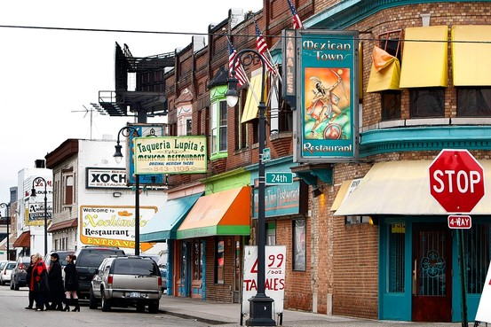
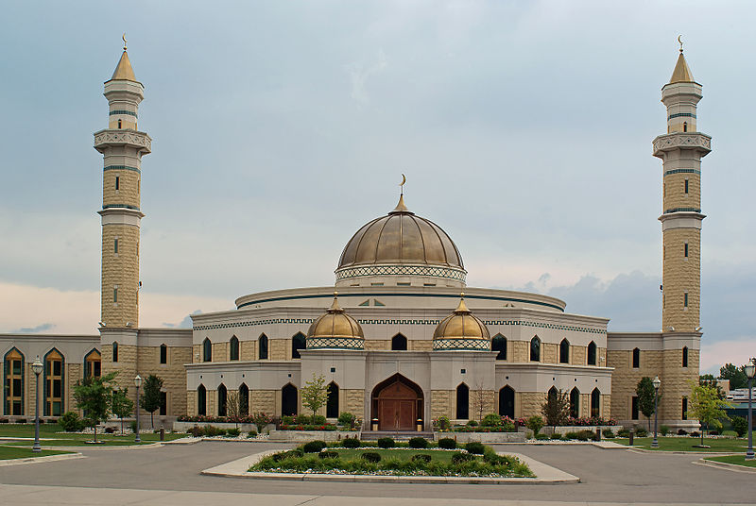
Legal/social Barriers to service
Parole violators/open warrants
Escaping domestic abuse
Asylum seekers/illegal immigrants
“Going ghost”
Use of ‘street’ names
Mental illness
Organic brain disease
Substance abuse
Traumatic brain injury
Mexicantown
Largest Arabic Expatriate Community
MSU Spartan Sagas 2010

Slide 12
Traumatic brain injury
Fame, fortune have faded away for Detroit boxer Willie Edwards
MIKE BRUDENELL DETROIT FREE PRESS SPORTS WRITER
June 12, 2011
He had a wife, two children and a dynamite right hand that could put you to sleep.
Willie (the Sandman) Edwards had the world at his feet and many opponents as well, whom he knocked down during his colorful boxing career in Detroit and across the country in the 1980s.
Now the Sandman hides in a dark corner of a downtown homeless shelter, where his most precious possessions are an old folding chair and a few memories of his ring career.
"I don't want to cry about anything,"
Source: Detroit Free Press 2011

Slide 13
Undocumented immigrants
Source: http://www.d9.uscgnews.com/go/doc/443/73003/
Busiest international border crossing in North America

Slide 14
TB skin testing – low follow up
D. Carpenter 2012
20.2 % of individuals who had PPD placed had the test read

Slide 15
Steps taken to Mitigate outcomes
Improving Filtration
Utilizing database for screening, referral and contact investigation
Switching from TST to interferon – γ release assay (IGRA) testing
Establishing close relationship with Detroit Health Department/other homeless service providers

Slide 16
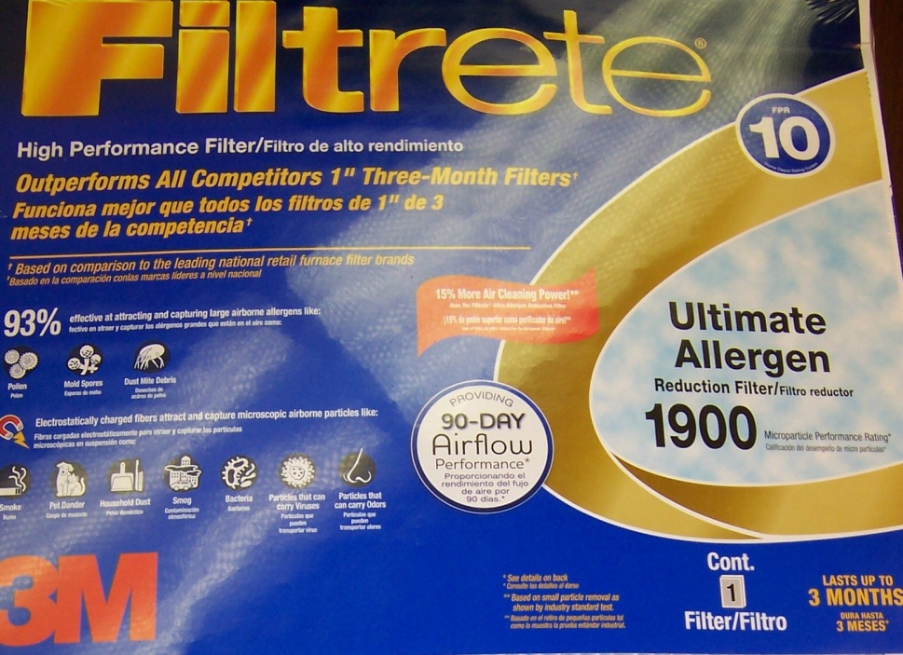
ventilation
D. Carpenter 2012
Fiber filters capture no pathogens
UVGI and HEPA filters are cost-prohibitive
Pleated filters show some efficacy are affordable

Slide 17
Filter efficacy
Source: Francis J Curry International TB Center

Slide 18
HMIS – homeless management information system
D. Carpenter 2012
A Statewide database - provides information on services rendered and
a screening tool/searchable database for contact investigation

Slide 19
scanning a consumer into HMIS
D. Carpenter 2012

Slide 20
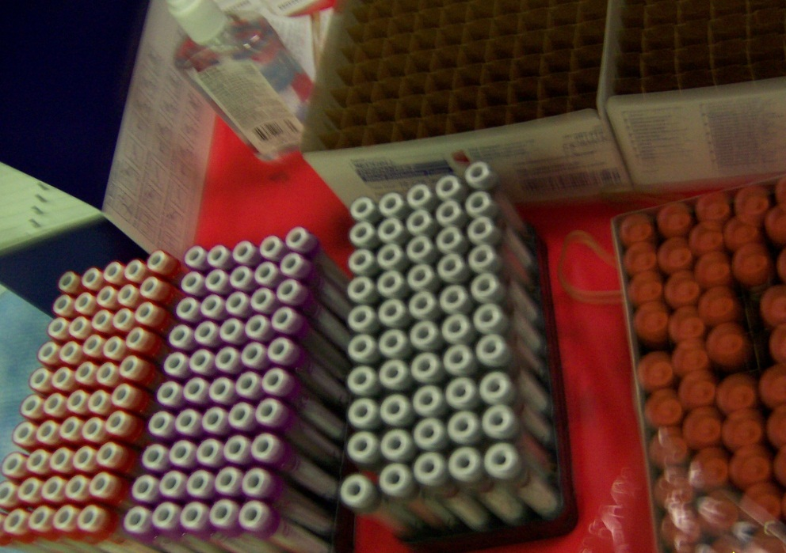
Quantiferon – TB Gold testing
D. Carpenter 2011

Slide 21
TB Testing – Detroit health department
D. Carpenter 2011
The “Crew” – providing not only Quantiferon TB testing,
but also HIV and syphilis testing.

Slide 22
Results of testing
92 Registered and screened
61 Tested (66.3% )
31 Refused (33.7%) or not available
5 Positive (8%)
+2 cases from contact investigation (not homeless and previously identified)
0 Active disease in reactors
1 Positive syphilis (1%)
0 Positive HIV test
Notes:
Herman Keifer lab closing 2/3/12.

Slide 23
observer.com

Slide 24
References
Brudnell, Mike. 2011. “Fame, fortune have faded away for Detroit boxer Willie Edwards.”
http://www.nso-mi.org/files/2011-06-12-detroit-free-press.pdf
City Farmer News. 2008 “Acres of Barren Blocks Offer Chance to Reinvent Detroit.”
http://www.cityfarmer.info/2008/12/23/acres-of-barren-blocks-offer-chance-to-reinvent-detroit/
Corporation for Supportive Housing. 2010.
http://www.avoidreadmissions.com/wwwroot/userfiles/documents/85/detroit-hospitals-fuse-9-15-10beam.pdf
Huffington Post. 2009. “Over Half Of Detroit Homeless Population At Risk Of Dying On City Streets.”
http://www.huffingtonpost.com/2010/04/09/over-half-of-detroit-home_n_532037.html
Michigan State University, 2011. Spartan Sagas.
http://spartansagas.msu.edu/spotlight/1013/

